Slide 1
A Hybrid Cloud Approach for Secure Authorized De-duplication
Presented By: Project Guide:

Slide 2
ABSTRACT
Data Deduplication is one of important data compression techniques for eliminating duplicate copies of repeating data, and has been widely used in cloud storage to reduce the amount of storage space and save bandwidth.
To protect the confidentiality of sensitive data while supporting Deduplication, the convergent encryption technique has been proposed to encrypt the data before outsourcing.
To better protect data security, this paper makes the first attempt to formally address the problem of authorized data Deduplication. Different from traditional Deduplication systems, the differential privileges of users are further considered in duplicate check besides the data itself.
We also present several new Deduplication constructions supporting authorized duplicate check in a hybrid cloud architecture. Security analysis demonstrates that our scheme is secure in terms of the definitions specified in the proposed security model.

Slide 3
As a proof of concept, we implement a prototype of our proposed authorized duplicate check scheme and conduct tested experiments using our prototype. We show that our proposed authorized duplicate check scheme incurs minimal overhead compared to normal operations.

Slide 4
EXISTING SYSTEM
In the existing system, the system protecting the data confidentiality by transforming the predictable message into unpredictable message.
Here another third party called key server is introduced to generate the file tag for duplicate check in which the data confidentiality is not more secured. Convergent encryption ensures data privacy in deduplication.
The system is formalized this primitive as message-locked encryption, and explored its application in space-efficient secure outsourced storage in which the system will take more time duration to encrypt and decrypt.

Slide 5
DISADVANTAGES OF EXISTING SYSTEM
The system will take more time to check data duplication in the cloud while using Convergent encryption techniques.
Identical data copies of different users will lead to different cipher texts, making de duplication impossible.
Data confidentiality will be loosed when third party key server is used for checking duplication.

Slide 6
PROPOSED SYSTEM
In this paper, aiming at efficiently solving the problem of deduplication with differential privileges in cloud computing, we consider a hybrid cloud architecture consisting of a public cloud and a private cloud.
Unlike existing data deduplication systems, the private cloud is involved as a proxy to allow data owner/users to securely perform duplicate check with differential privileges.
Such an architecture is practical and has attracted much attention from researchers. The data owners only outsource their data storage by utilizing public cloud while the data operation is managed in private cloud.
A new deduplication system supporting differential duplicate check is proposed under this hybrid cloud architecture where the S-CSP resides in the public cloud.

Slide 7
The user is only allowed to perform the duplicate check for files marked with the corresponding privileges.
ADVANTAGES OF PROPOSED SYSTEM:
The user is only allowed to perform the duplicate check for files marked with the corresponding privileges.
We present an advanced scheme to support stronger security by encrypting the file with differential privilege keys.
Reduce the storage size of the tags for integrity check. To enhance the security of deduplication and protect the data confidentiality.
There is no any external key server to check the duplication, instead the duplication is checking in cloud server itself.

Slide 8
SYSTEM REQUIREMENT
Hardware Requirements:
System : Pentium IV 3.5 GHz.
Hard Disk : 40 GB.
Floppy Drive : 1.44 Mb.
Monitor : 14’ Colour Monitor.
Mouse : Optical Mouse.
Ram : 1 GB.

Slide 9
Software Requirements:
Operating system : Windows XP or Windows 7, Windows 8.
Coding Language : Java – AWT, Swings, Networking
Data Base : My Sql / MS Access.
Documentation : MS Office
IDE : Eclipse Galileo
Development Kit : JDK 1.6

Slide 10
PROBLEM DEFINATION
The problem of the system is to private cloud which is involved as a proxy to allow data owner/users to securely perform duplicate check with differential privileges.
Such architecture is practical and has attracted much attention from researchers.
The data owners only outsource their data storage by utilizing public cloud while the data operation is managed in private cloud.

Slide 11
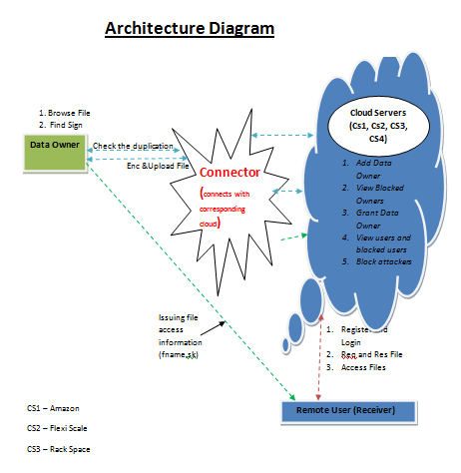
ARCHITECTURE

